Slide 1
Summary: Deep Learning time
畅星兆，2019.08.28

Slide 2
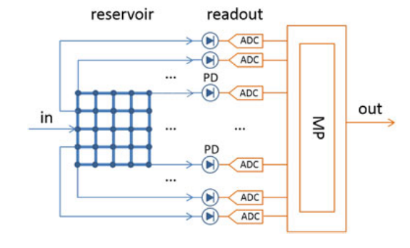
水库计算
强调new paradigm, analog computing,
Readout: machine learning on digital computers.
Micro processor
(Katumba et al., Neuromorphic Computing Based on Silicon Photonics and Reservoir Computing, IEEE Journal of Selected Topics in Quantum Electronics, 2018)
We show how passive reservoir computing chips can be used to perform a variety of tasks (bit level tasks, nonlinear dispersion compensation, etc.) at high speeds and low power consumption.

Slide 3
Analog computing paradigm
a promising implementation, relies on certain physical systems and evolution of the internal state.
typically coupled to a readout system to guide the evolution of the system state towards a solution. (transform the observed physical signal into interpretation by digital computers)
Machine learning
applied in the readout system to teach computer systems how to perform (or interpretate) complex tasks.
calculated in the electrical domain

Slide 4
Training Optical Readouts
separate high-photodetectors
photodetectors tend to be costly due to footprint
can only measure the intensities
trains the weights based on simulation
fabrication tolerances
pretraining-retraining
fabrication tolerances
single high-photodetectors(prefer)
does take some time
still requires external microprocessor

Slide 5
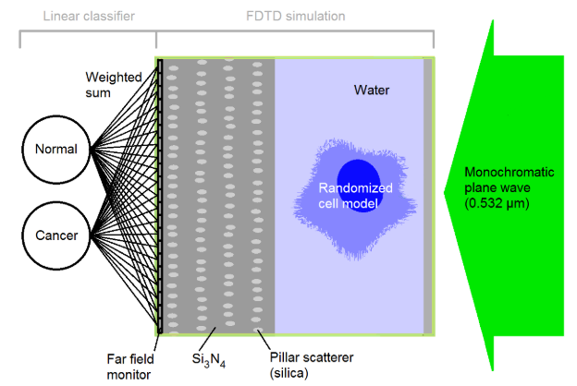
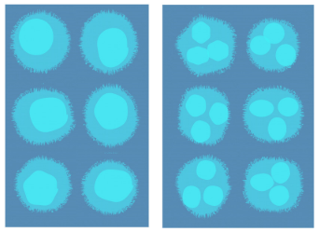
Pillar scatterer paradigm
monochromatic plane wave
pillar: randomly generated, kept fixed
simulation: cells and pillar scatterer (by setting some rules)
fast and energy efficiency: when running models (not training)
application: high throughput label-free cell sorting
Normal cells and cancer cells form two clusters after calculating weighted sum.
(Alessio Lugnan et al., Integrated pillar scatterers for speeding up classification of cell holograms, Optics Express, 2017)
generated“normal” and “cancer”cell

Slide 6
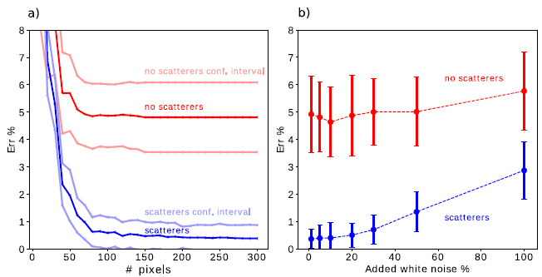
Result
a considerable error rate reduction
classification performance increase more than 50%
(4 layers, Ar = 150 nm, D = 2.85 um, UV (337.1 nm) laser source)

Slide 7
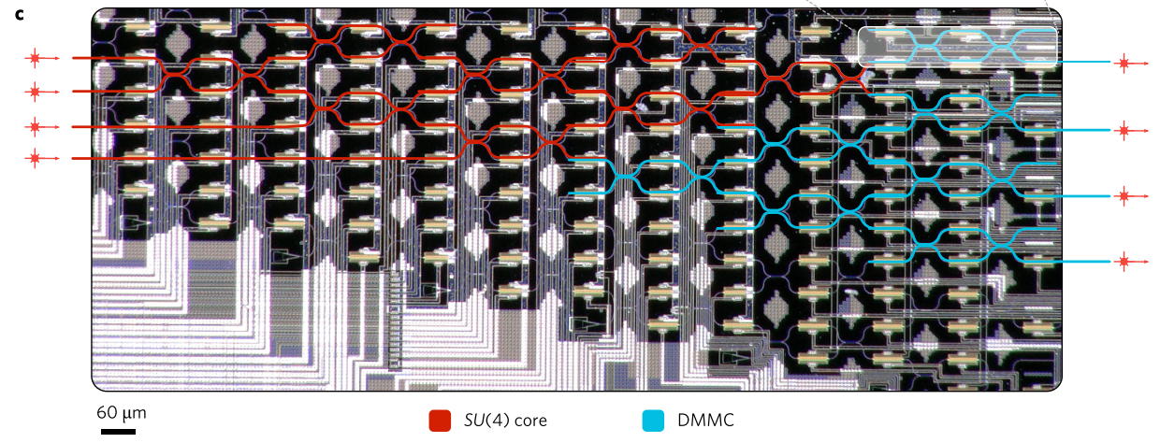
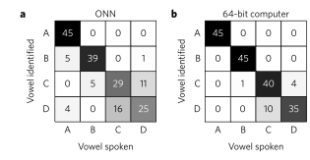
Deep Learning with coherent nanophotonic circuits
(Shen Yichen etal., Deep learning with coherent nanophotonic circuits, Nature Photonics, 2017)
Featuring a cascaded array of 56 programmable Mach-Zehnder interferometers
Power efficiency
Vowel recognition
comparable results
We trained the matrix parameters with the standard back-propagation algorithm using a stochastic gradient descent method on a conventional computer.

Slide 8
调研：翻折目镜
Thorlab调研
网站：未找到
销售代表：未找到
Olympus调研
网站：未找到
销售代表：正在整理（显微镜物镜切换盘？）

Slide 9
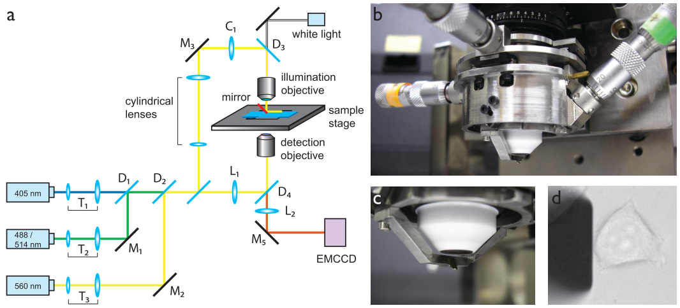
反射镜
组成：自制的xyz位移台+AFM悬臂（AFM cantilever）
自制的xyz位移台：4个不锈钢圆筒，第一个固定在物镜上，其余三个级联，分别用于控制悬臂在三个维度上运动。
AFM悬臂：通过镀膜形成反射镜。
a：示意图，b：实拍图，c：近照，d：宽场图像
(Gebhardt et al., Nature Methods, 2013)

Slide 10
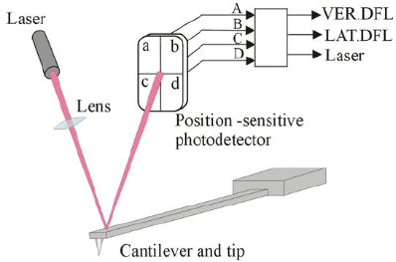
AFM Cantilever
AFM原理图
文中：HYDRA2R-100N-TL-10, Nanoscience（not found）
处理：(custom-coated, thermal evaporation)1 nm Ti layer followed by 40 nm Al layer
(https://wenku.baidu.com/view/ad63ad0b01f69e31433294db.html)

